Slide 1
NL TO OCL CONVERTER
SOFTWARE ENGINEERING
ABDUL REHMAN SHAIKH (17B-067-SE)
MUHAMMAD UMAID (17B-073-SE)
USMAN SAEED (17B-079-SE)
MUHAMMAD HASSAN SIDDIQUI (17B-110-SE)

Slide 2
PROBLEM STATEMENT AND MOTIVATION
OCL is basically used to express constraint used in UML Diagrams in defined criteria or syntax. But the syntax is very complex, so it is hectic to implement or when creating OCL statements manually results mainly in inaccuracy.
Our approach aims at simplifying process of generation of OCL statements. It requires an automate approach that automatically translates NL to OCL statements with SBVR rules.

Slide 3
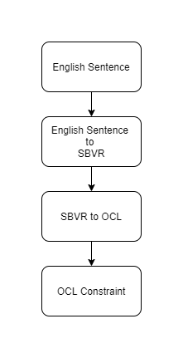
PROJECT FLOW

Slide 4
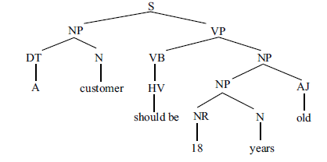
SOLUTION
The aim is to produce an automated approach so that the user can write constraints in English and the framework converts such natural language expressions to the equivalent OCL statements using SBVR.
This process consists of two major parts:
NL TO SBVR:
Lexical Processing
Syntactic Analysis
(eg. A customer should be 18 years old)
Semantic Analysis
. The major challenge in NL to SBVR transformation is complex semantic analysis which is resolve by SBVR rules.

Slide 5
SOLUTION (2)
2. SBVR to OCL

Slide 6
TECHNOLOGY PROPOSED
PlugIn Tool for any open-source m.
Python to design the TOOL for conversion.

Slide 7
SUGGESTED SUPERVISOR
Muhammad Misbahuddin (Assistant Professor)

